Slide 1
Programming Environment and Package Installation
Programming for Data Analysis (CT127-3-2-PFDA and Version VC1)
Copyright 2016 Asia Pacific Institute of Information Technology

Slide 2
Topic & Structure of the lesson
Overview of:
R Programming Language
R Environment
R Packages
Install and Uninstall
Load and Unload

Slide 3
Learning Outcomes
At the end of this topic, you should be able to:
Understand the R environment.
Understand the concept of packages used in the RStudio.

Slide 4
Key Terms you must be able to use
If you have mastered this topic, you should be able to use the following terms correctly in your assignments and exams:
Rstudio
Packages

Slide 5
What is R ?
R is a programming language developed by Ross Ihaka and Robert Gentleman in 1993.
R is commonly used in statistical computing, data analytics and scientific research.
It is one of the most popular languages used by statisticians, data analysts, researchers and marketers to retrieve, clean, analyze, visualize and present data.

Slide 6
Why use R ?
R is open Source and free.
R is popular – and increasing in popularity.
R runs on all platforms.
Learning R will increase your chances of getting a job.

Slide 7
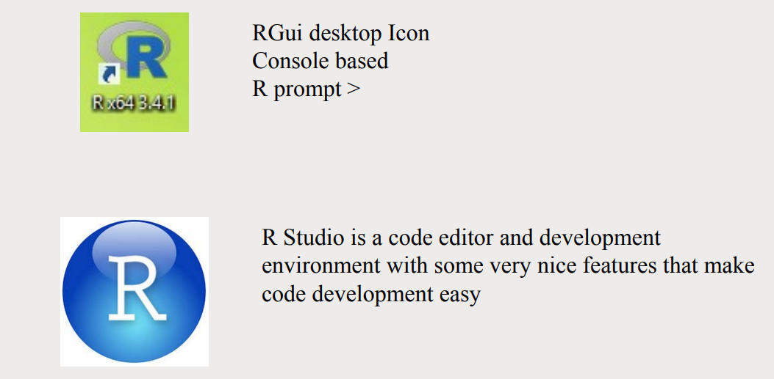
R Environment

Slide 8
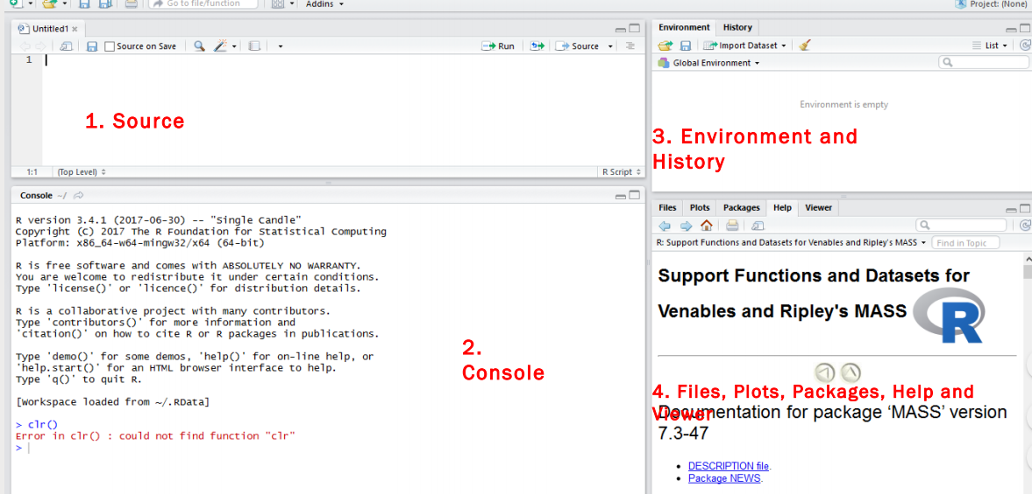
R Environment

Slide 9
R Environment
Source
- Top left corner of the screen contains a text editor that lets you work with source script files.
- Here, you can enter multiple lines of code, save your script files to disk, and perform other tasks on your script.
Console
- This is where you do all the interactive work with R.
Environment and History
Here you can inspect the variables you created in your session, as well as their values.
Files, plots, package, help, and viewer
- Here you can see the files upload, graphs generated, Help option, package description

Slide 10
R Package
A package is essentially a library of pre-written code designed to accomplish some task or a collection of task.
CRAN, the official repository maintained by R community
There were more than 15,000 packages available on CRAN.
e.g.: ggplot2 is used for plotting the graph.
dplyr is used for data manipulation.
crayon is used for colored terminal output.

Slide 11
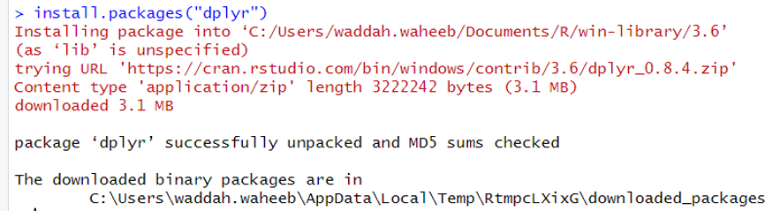
Installing Packages
The simplest is to install them using the GUI provide by RStudio.
Access packages by clicking its tab or ctrl+7 on the keyboard.
An alternative is to type
install.packages(“dplyr”)

Slide 12
Uninstalling Packages
For uninstalling packages
remove.packages (“dplyr”)

Slide 13
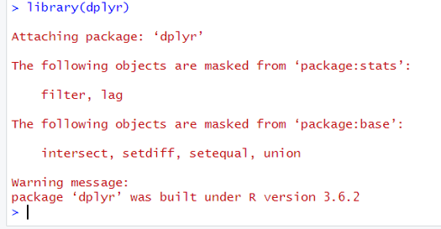
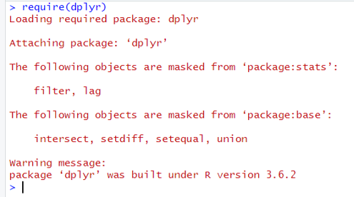
Loading Packages
After installation, the packages need to be loaded first.
For loading a package:
library(dplyr)
require(dplyr)
* If you removed dplyr package, you need to install it again before loading it.

Slide 14
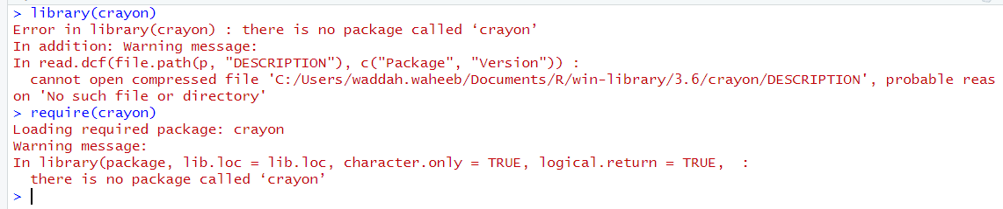
Loading Packages
require returns FALSE and gives a warning (rather than an error as library does by default) if the package does not exist.

Slide 15

Unloading Packages
For unloading packages
>detach(“package:dplyr”)

Slide 16
Quick Review Question
What is an environment in R ?
What is a package in R?
How to install and uninstall packages?
How to load and unload packages?

Slide 17
Summary of Main Teaching Points
R programming.
R environment.
R packages.
Install and uninstall packages.
Load and unload packages.

Slide 18
Question and Answer Session
Q & A
Book consultation slots for assistance.

Slide 19
Next Session
Basics of R Programming

